Slide 1
\
AD & AS

Slide 4
Economic activity fluctuates from year to year. In most years, the production of goods and services rises. Because of increase in labour force, increase in the capital stock, and advances in technological knowledge, the economy can produce more and more over time. This growth allows everyone to enjoy a higher standard of living.

Slide 5
In some years this normal growth does not occur. Firms find themselves unable to sell all of the goods and services they have to offer, so they cut back the production. Unemployment rises and factories are left idle. With the economy producing fewer goods and services, real GDP and other measures of income fall. Such a period of falling incomes and rising unemployment is called a recession if it is relatively mild and depression if it is more severe.

Slide 6
Falling output and rising prices is known as stagflation.

Slide 7
short-run economic fluctuations: The Assumption of Classical Economies
Classical Dichotomy: is the separation of variables into real variables (those that measures quantities or relative prices) and nominal variables (those measured in terms of money).
Classical Dichotomy arises because, in classical theory, changes in the money supply do not influence real variables. This irrelevance of money for real variables is called monetary neutrality.

Slide 8
The Reality of Short-Run Fluctuations
Do these assumptions of classical macroeconomic theory apply to the world in which we live? No
Most economists believe that classical theory describes the world in the long run but not in the short run.
In the short run, real and nominal variables are highly intertwined, and changes in the money supply can temporarily push real GDP away from its long-run trend.
Even the classical economists themselves, such as David Hume, realized that classical economic theory did not hold in the short run.

Slide 9
To understand how the economy works in the short run, we need a new model. Our new model focuses on how real and nominal variables interact.
The model of Aggregate Demand and Aggregate supply.

Slide 10
The model of Aggregate Demand and Aggregate supply
The model of short run economic fluctuations focus on the behavior of two variables.The first variable is the economy’s output of goods and services, as measured by real GDP. The second is the average level of prices, as measured by the CPI or GDP deflator.
Notice that output is a real variable, where as the price level is a nominal variable.By focusing on the relationship between these

Slide 11
Two variables, we are departing from the classical assumption that real and nominal variables can be studied separately.

Slide 12
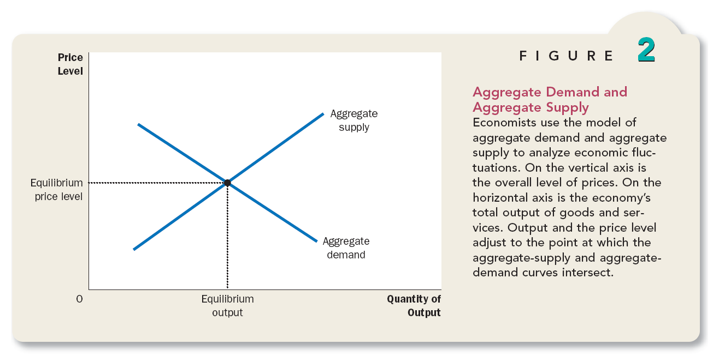

Slide 13
The aggregate demand curve shows the quantity of goods and services that households, firms, the govt, and customers abroad want to buy at each price level.
The aggregate supply curve shows natural rate of output and price level.

Slide 14
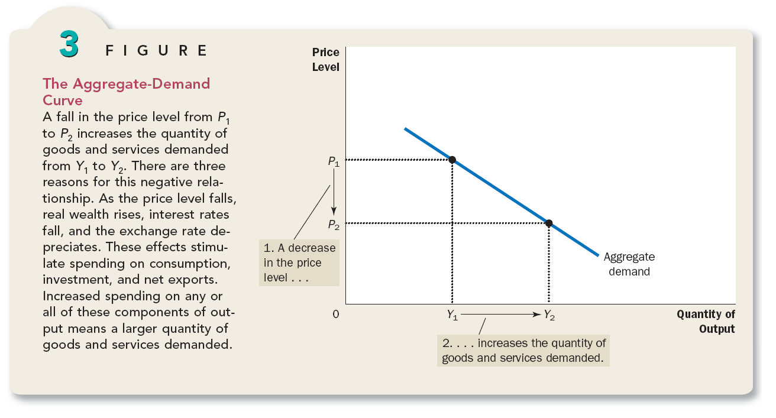

Slide 15
Price Level and Consumption
P↓→Real value of money↑ and consumers wealthier, which encourage them to spend more in goods and services.
↑Consumer spending means larger QD.
Conversely,
P↑→ Real value of money↓→ Wealth↓→ Consumer spending means smaller QD↓

Slide 16
The Price level and Investment
The price level is one determinant of the quantity of money demand.
P↓(lower price) → less money household needs to buy goods and services they want →Household try to reduce their holdings of money by lending some of it out means to buy interest-bearing bonds or deposit it excess money in an interest bearing saving accounts, and bank would use these funds to make more loans. In either case, as households try to convert some of their money into interest-bearing assets, they drive down interest rate(↓). → borrowing less expensive → borrow more to invest in new plants, equipments (firms) ↑→house hold borrow more to invest in new housing, consumer durables (which are bought on credit) ↑.

Slide 17
This gives the second reason the aggregate demand curve is downward sloping.
P↓→r.o.i↓→encourage greater spending on investment goods, and thereby increases the quantity of goods and services demanded↑. Conversely,
P↑→r.o.i↑→reduce the investment spending and the quantity of goods and services demanded↓.

Slide 18
The Price Level and Net Exports
P↓→r.o.i↓→in response to lower r.o.i, some Indian investors will seek higher returns by investing abroad. For instance, as the r.o.i on Indian govt bonds falls, a mutual fund might sell Indian govt bonds to buy German bonds. As the mutual fund tries to convert its rupees into euros to buy the German bonds, it increases the supply of rupees in the market for foreign-currency exchange. The ↑ss of Rupees to be turned into euros causes the rupees to depreciate relative to the euro. This leads to a change in the real exchange rate- the relative price of domestic and foreign goods. Because each rupees buys fewer units of foreign currencies, foreign goods becomes more expensive relative to domestic goods.
The change in relative prices affects spending, both at home and abroad. Because foreign goods are more expensive,Indian buys less from other countries, causing India imports of goods and services to decrease.At the same time, because India goods are now cheaper, foreigners buy more from India, so India exports increase. Net exports equal exports minus imports,so both of these changes cause India net exports to ↑ increase. Thus, the fall in the real exchange value of rupees leads to an increase in QD.

Slide 20
It is important to keep in mind that the aggregate-demand curve (like all demand curves) is drawn holding “other things equal.”In particular, our three explanations of downward-sloping aggregate-demand curve assume that money supply is fixed.
We will see in the next chapter, a change in the quantity of money shifts the aggregate-demand curve. At this point just keep in mind that the aggregate-demand curve is drawn for a given quantity of money.

Slide 21
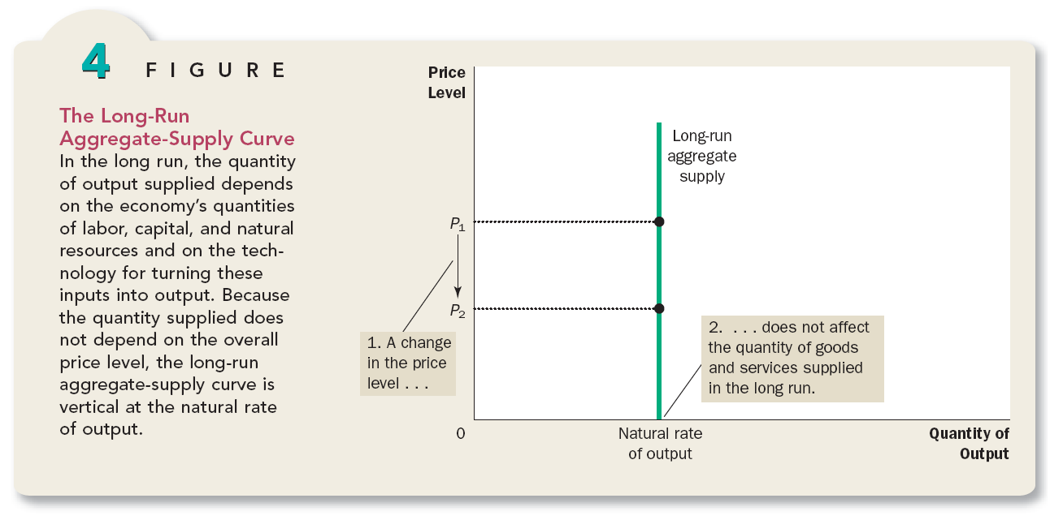

Slide 22
Why the Aggregate-Supply Curve is Vertical in the Long Run ?
In the long run, an economy’s production of goods and services (its real GDP) depends on its supplies of labour, capital, and natural resources and on the available techonology used to turn these factors of production into goods and services.
The vertical L-R aggregate supply curve is a graphical representation of classical dichotomy and monetary neutrality. Most economists believe that this principle works well when studying the economy over a period of many years but not when studying year – to – year changes.

Slide 23
Why the Aggregate-Supply Curve is Vertical in the Long Run ?
The long run level of production is sometimes called potential output or full-employment output. To be more precise, it is the natural rate of output because it shows what the economy produces when unemployment is at its natural, or normal,rate.The natural rate of output is the level of production towards which the economy gravitates in the long run.

Slide 24
Shifts in the long run aggregate supply curve
Shift Arising from Changes in Labour: Imagine that an economy experiences an increase in immigration. There would be a greater number of workers, the quantity of goods and services supply would increase. As a result, the long run aggregate supply curve would shift to the right. Conversely, if many workers left the economy to go abroad, the L-R aggregate supply curve would shift to the left.

Slide 25
Shift Arising from Changes in Capital
An increase in the economy’s capital stock increases productivity, thereby, the quantity of goods and services supplied. As a result, the long-run aggregate supply curve shifts to the right.
Conversely, a decrease in the economy’s capital stock decreases productivity and the quantity of goods and services supplied, shifting the L-R aggregate supply curve to the left.

Slide 26
Long run aggregate supply curve shifts arising from changes in natural resources.
As the production depends on the natural resources, including land, minerals and weather. A discovery of new mineral deposit shifts the long run aggregate-supply curve to the right.
A change in weather patterns that makes farming more difficult shifts the L-R aggregate-supply curve to the left.

Slide 27
Long run aggregate supply curve shifts arising from changes in technological knowledge. The invention of computer, for instance, has allowed us to produce more goods and services from any given amounts of labour, capital, and natural resources. As the computer use has spread throughout the economy, it has shifted the L-R aggregate supply curve to right.

Slide 28
Long-run aggregate curve reflects the classical model of the economy. Any policy or event that raised real GDP can be described as increasing the quantity of goods and services supplied and shifting the long run aggregate supply curve to the right.
Any policy or event that lowered real GDP can be described as decreasing the quantity of goods and services supplied and shifting the long run AS curve to the left.

Slide 30
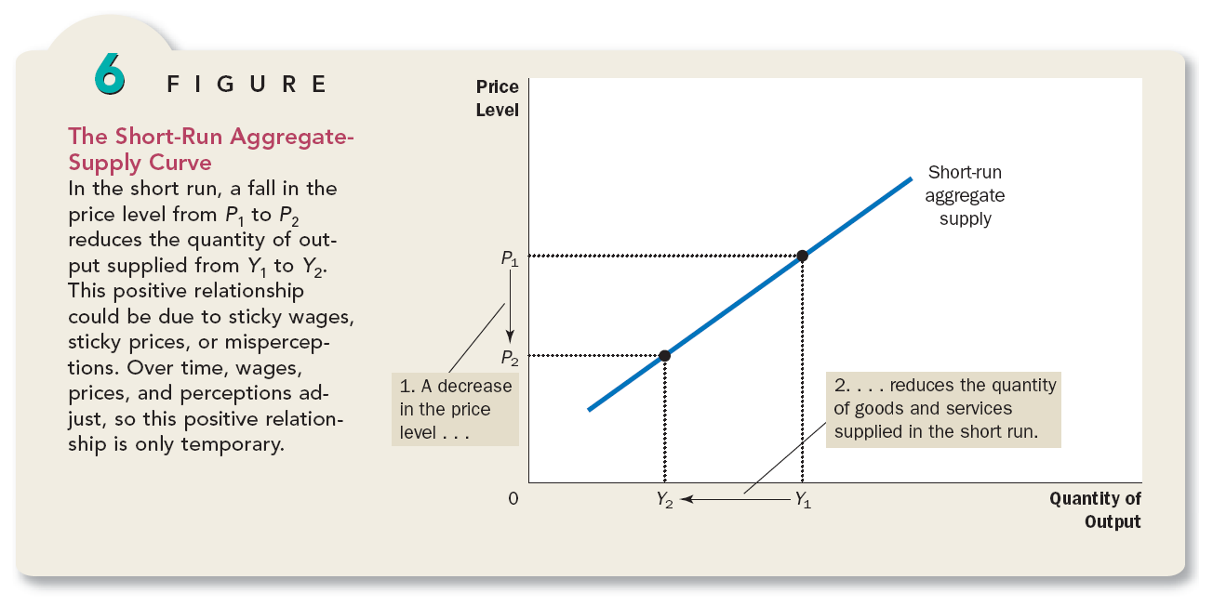

Slide 31
Sticky Wage Theory
  According to this theory SR Aggregate Supply curve slopes upward because nominal wages are slow to adjust to changing economic condition.
  When firm prices are fall below expectations, the firm get less price than expected for each unit of product it sells.As the production is now less proftable, so the firm higher fewer workers and reduces the quantity of output supplied.Over time,labour contract will expire and firm will renegotiate with it workers for a lower wage (which they may accept because of lower prices).

Slide 32
The Sticky-Price Theory
This theory emphasizes that the price of some goods and services also adjust sluggishly in response to changing economic conditions. The slow adjustment of prices occur because there are cost to adjusting prices, called menu costs. These menu costs include the cost of printing and distributing catalogs and the time required to change price tags. As a result of these costs, prices as well as wages may be sticky in the short run.

Slide 34


